Slide 1
Fingerprint Recognition System by Minutia Extraction & Self-Organization Maps
Project by:
Rohit Mandge
Amruta Gurav
Nikita Bafna
Under the guidance of
Prof. Vijay R Bhosale
Department of Computers
MGM’s College of Engineering & Technology, Navi Mumbai

Slide 2
Problem Statement
To design an efficient Fingerprint Recognition System by using Minutiae Extraction.
Perform Classification of fingerprints in the database using Artificial Neural Networks, i.e. Self-Organization Maps (SOM).

Slide 3
Fingerprint Recognition
Introduction:
What is Fingerprint?
A fingerprint is the feature pattern of one finger.
It is believed with strong evidences that each fingerprint is unique. Each person has his own fingerprints with the permanent uniqueness.
So fingerprints have being used for identification and forensic investigation for a long time.
Approaches for Fingerprint Recognition:
Minutia-based
Image-based

Slide 4
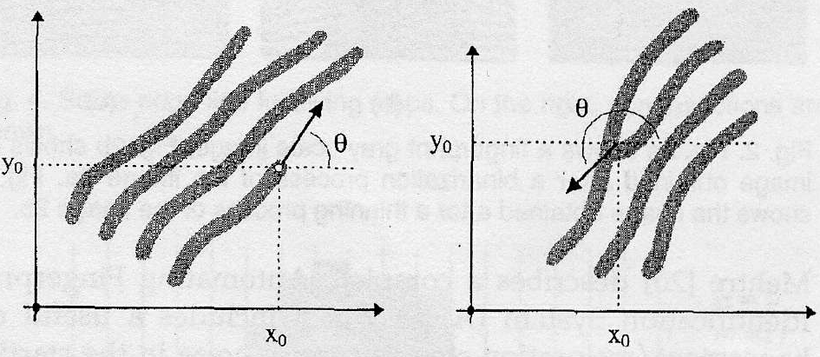
Minutiae-Based Approach
Minutiae
terminations bifurcations
Ridge Valley

Slide 5
Verification (AFAS) vs. Identification (AFIS)
System Level Design
User’s
Magnetic
Card….
User
System
Database
1:1 Match Verification
User ID
Minutia
Extractor
Minutiae Matcher
Sensor
1:m Match
Identification
System
Database

Slide 6
Algorithm Level Design
Minutia Extractor:
Image Enhancement
Image Binarization
Image Segmentation
Preprocessing
Minutia extraction
Thinning
Minutiae Marking
Post-processing
Remove False Minutiae
Minutia Matcher:
Alignment Stage
Match Stage

Slide 7
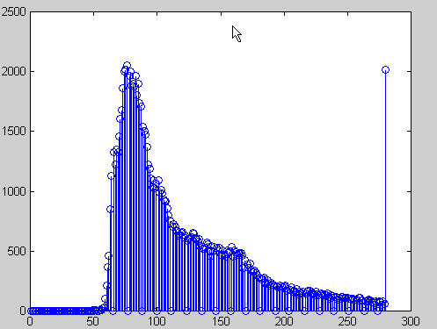
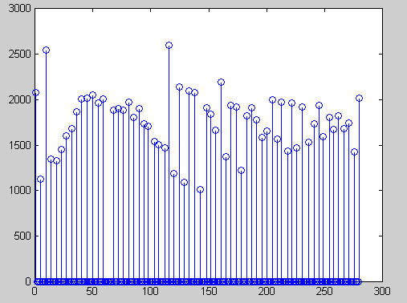
Fingerprint Image Enhancement
Histogram Equalization
Histogram equalization is used to expand the pixel value distribution of an image so as to increase the perceptional information.
The original histogram
Histogram after equalization

Slide 8

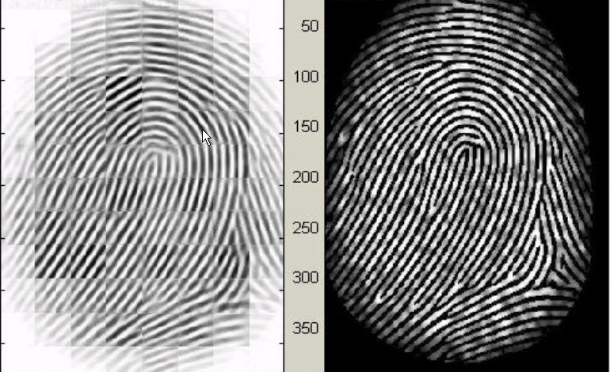
Fingerprint Image Enhancement
Fourier Transform
We divide the image into small processing blocks (32 by 32 pixels) and perform the Fourier transform according to:
for u = 0, 1, 2, ..., 31 and v = 0, 1, 2, ..., 31.
Get the enhanced block by,
Fingerprint enhancement by FFT
Enhanced image (left), Original image (right)

Slide 9
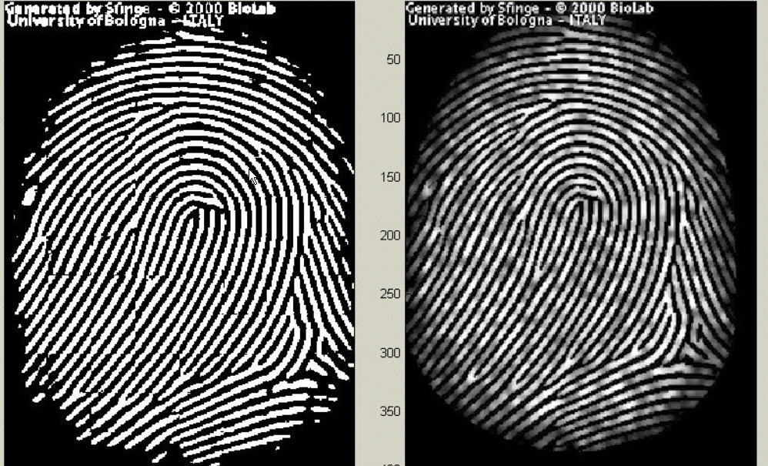
Fingerprint Image Binarization
Fingerprint Image Binarization is to transform the 8-bit Gray fingerprint image to a 1-bit image with 0-value for ridges and 1-value for furrows.
After the operation, ridges in the fingerprint are highlighted with black color while furrows are white.
Fingerprint image after adaptive binarization Binarized image(left), Enhanced gray image(right)

Slide 10
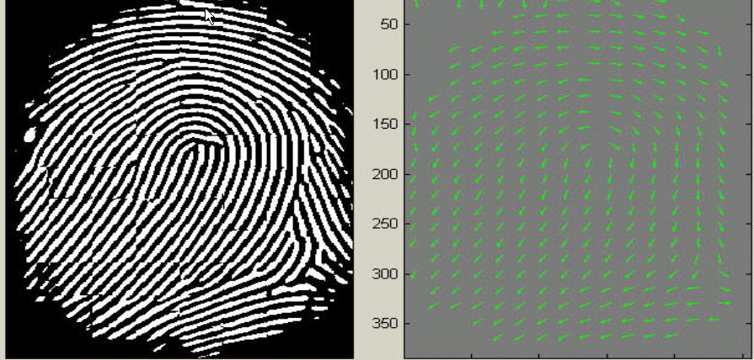
Minutia Extractor- Segmentation
Block directional estimation
Direction map. Binarized fingerprint (left), Direction map (right)

Slide 11



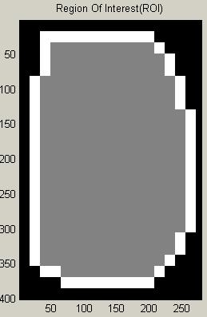
Fingerprint Image Segmentation
ROI Extraction by Morphological Operations:
Two Morphological operations called ‘OPEN’ and ‘CLOSE’ are used.
The ‘OPEN’ operation can expand images and remove peaks introduced by background noise.
The ‘CLOSE’ operation can shrink images and eliminate small cavities.
Original Area
After Close Operation
After Open Operation
ROI + Bound

Slide 12
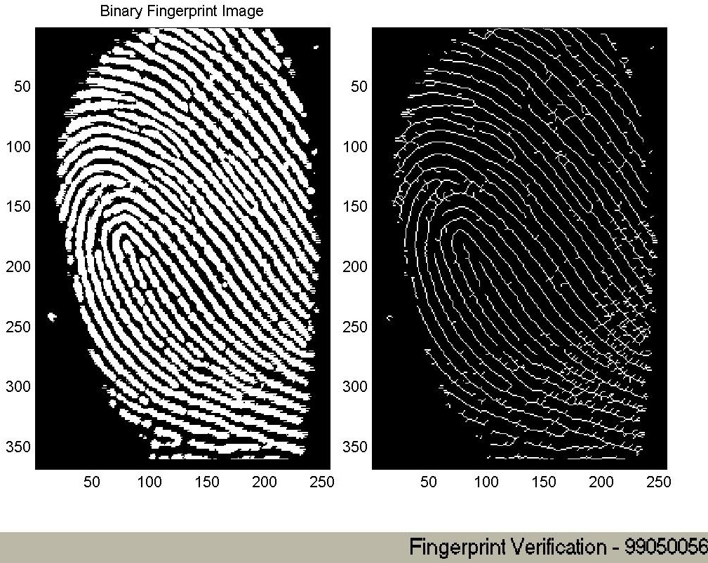
Minutia Extraction Stage - Thinning
Ridge Thinning is to eliminate the redundant pixels of ridges till the ridges are just one pixel wide.

Slide 13
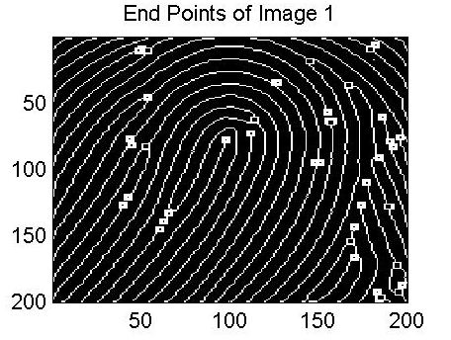
Minutia Extraction Stage - Minutia Marking
Preprocessing Steps:
0 | 1 | 0
0 | 1 | 0
1 | 0 | 1
Bifurcation
0 | 0 | 0
0 | 1 | 0
0 | 0 | 1
Termination

Slide 14
Post-processing stage
False Minutia Remove:
Examples of False Minutia

Slide 15
Minutia Match
Given two set of minutia of two fingerprint images, the minutia match algorithm determines whether the two minutia sets are from the same finger or not.
It includes two consecutive stages:
Alignment stage.
Match stage.

Slide 16
Minutia Match
Alignment – based Algorithm :
Ridge direction
Ridge information is used to determine the goodness of a reference Minutia pair
ridge
y
If two ridge are matched well Continue use the
Relax Box Match Or
Use
String Match
Minutia
x0 x1 x2 x3 x4 x5 x6 x

Slide 17
Minutia Match
Simple Relax Match Algorithm :
For any two minutia from different image, If They are in a box with small length And their direction has large consistence
They are Matched Minutia
Match Score = Num(Matched Minutia)
Max(Num Of Minutia (image1,image2));

Slide 18
Fingerprint Classification by SOM
Introduction – Topics about Fingerprint
Fingerprint Sensor
Fingerprint Image
Preprocessing
Fingerprint
Classification
Fingerprint
Image
Compression
Fingerprint
Matching
18

Slide 19
SOM Algorithm & Implementation details
Feature vector Generation
A 256-dimension feature vector for each fingerprint image is generated.
The feature vector generation stage is an important part for keeping the accuracy of the classification system.
The four stages are:
1)Block Direction Estimation
2)Segmentation
3)Core point detection
4)Regulate the feature vector

Slide 20
How to Classify Fingerprints by SOM
Introduction - SOM
X1
X2
X3
w11
w13
1
w14
w12
3
2
4
2x2 SOM
An Input vector X = {x1,x2,x3}
20

Slide 21
How to Classify Fingerprints by SOM
For a well-trained SOM:
X1
X2
X3
w11
w13
1
Winning Node
w14
w12
3
So the Input vector X is class 3 !
2
4
2x2 SOM
An Input vector X = {x1,x2,x3}
21

Slide 22
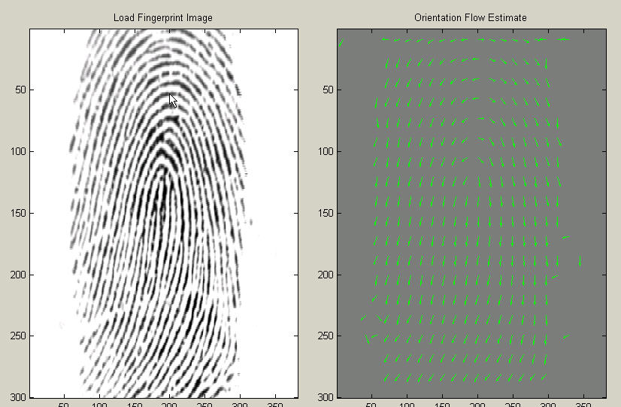
Segmentation
The Feature Vector of a Fingerprint X:
1. X has dimension 1 x 256: {x1,x2,….x256}
2. It is the directional Map
22
Extract Fingerprint region Extract Effective Region

Slide 23
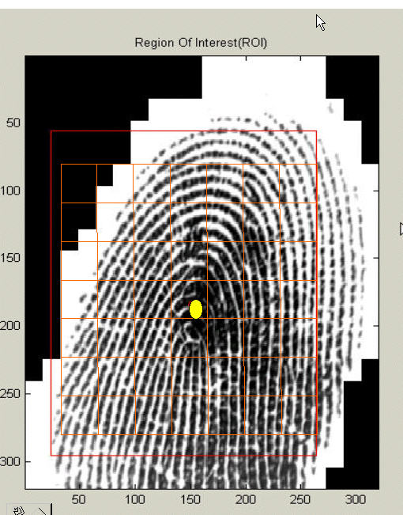
Locating Fingerprint Core
The region with a largest value in center, which also continuously connects with a largest neighborhood area before the value reduces to a threshold, is used to locate the core.
90% fingerprints centers
are located correctly

Slide 24
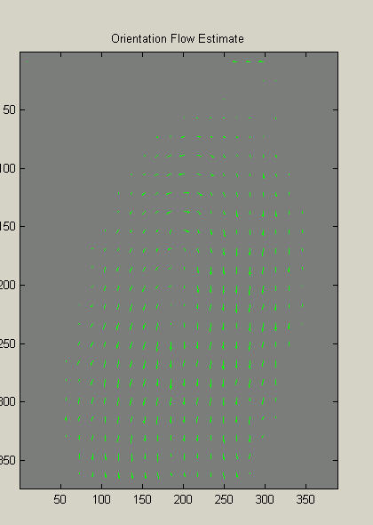
Regulate the Feature Vector
Uncertainty Value:
[0, 1]
1.Directions in the good-quality region has good certainty;
2.In the Left figure:
Larger certainty
Longer amplitude

Slide 25
SOM Algorithm &
Implementation details
B. SOM construction and training
Construct a MxM SOM, initialize all the weights
Input a fingerprint vector: {x1,x2,….x256}
Find the winning node dmin where: Dmin = min{||x-w||}
Update the weight vectors:
W(new) =W(old) + Alpha*N*[x-w]
Where N is the neighborhood function corresponding to the SOM node topology
5. Repeat 2-4 till Update is not significant
Training Algorithm1: Original SOM
25

Slide 26
SOM Algorithm &
Implementation details
Training Algorithm2: Modified SOM
Note: Each fingerprint is associated with a certainty vector C
Construct a MxM SOM, initialize all weights
Input a fingerprint vector: X{x1,x2,….x256} = C*X + (1-C)*X_{avg};
Find the winning node dmin where: Dmin = min{||x-w||}
Update the weight vectors:
W(new) =W(old) + Alpha*N*[x-w] * C
Where N is the neighborhood function corresponding to the SOM node topology
5. Repeat 2-4 till Update is not significant

Slide 27
Conventional System & Proposed System
Classic Approach – The Henry System
The goal of classic fingerprint classification system is to assign a working formula to a set of fingerprints, which will enable the set of prints to be classified or located in a file.
Henry system is one of such method which makes use of the complete set of 10 fingerprint patterns of both hands to classify a person.

Slide 28
Conventional System & Proposed System
Proposed System
We propose Fingerprint classification by using self-organization map (SOM).
Both a conventional and a modified SOM algorithm are used to fulfill the task. Also different approaches from the literature for retrieving the feature vectors of fingerprints and for fully making use of the available SOM toolbox play a critical role to keep our classifier system efficient and robust.

Slide 29
Results Search% column : percentage searched in DataA Recognition% Column: percentage found for DataB
SEARCH%
RECOGNITION
3x3
4x4
5x5
8x8
10x10
M
10
12.1
18.8
28.8
91.8
100
S
20
26.0
38.7
54.0
100
O
30
40.1
61.3
80.5
M
40
55.9
86.6
100
50
71.9
100
60
88.5
70
100
80
90
100
10
19.6
16.4
26.4
40.0
62.7
S
20
39.6
38.1
53.1
100
100
O
30
57.3
60.9
82.5
M
40
72.9
84.8
100
50
86.3
100
60
97.5
70
100
80
90
100

Slide 30
CONCLUSION
Our project has combined many methods like segmentation using Morphological operations, minutia marking with special considering the triple branch counting, minutia unification by decomposing branch into three terminations in MATLAB which enhances the test results.

Slide 31
References
[1] L. Hong., “Automatic Personal Identification Using Fingerprints”. PhD thesis, Michigan State University, 1998.
[2] SOM MATLAB Tool Box, http://www.cis.hut.fi/projects/somtoolbox/
[3] L.C. Jain, U. Halici, I. Hayashi, S.B. Lee and S. Tsutsui, “Intelligent biometric techniques in fingerprint and face recognition”, 1999, the CRC Press.
[4] Anil Jain, Sharath Pankanti, “Fingerprint Classification & Matching”, Exploratory Computer vision Group, IBM T.J. Watson Research Center.
[5] Wikipedia, “Self- organizing Maps”, www.wikipedia.com/self_organising_maps/
[6] L. Hong, Y. Wan, and Anil K. Jain, “Fingerprint Image Enhancement: Algorithm & performance algorithm”. IEEE Transactions on Pattern Analysis & Machine Intelligence, 20(8):777 {789}, May 1998.
[7] Halici U., Ongun G. “Fingerprint Classification through Self Organization Maps Modified to Treat Uncertainties”, Proceedings of the IEEE, Vol84, No10, pp1497 1512, October 1996.

Slide 32
THANK YOU

